Slide 1
Controller layout design
Yimin Wang
2017-11-10

Slide 2
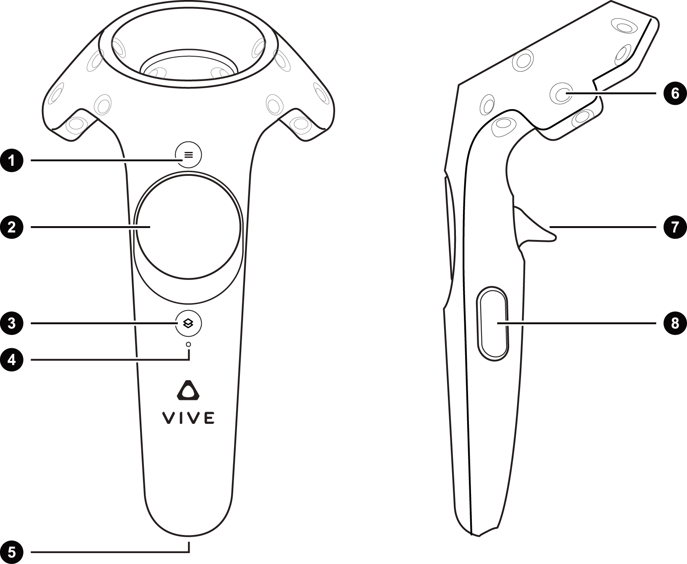
Left controller
ON LY
REDO
LINES ONLY
Save
N
A
Change
Color
v
I
Switch

Slide 3

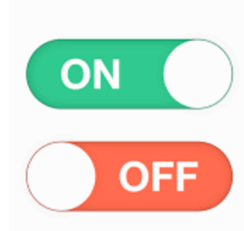
Right controller
尝试这两种风格，也是做成左右半圆
Function list:
Line/surface
Clear
Freeze
Virtual finger
Search 1 / Search 2
Quit
ON OFF
Switch
Current setting:
Virtual finger

Slide 4
modification
字体：Helvetica

